Slide 1
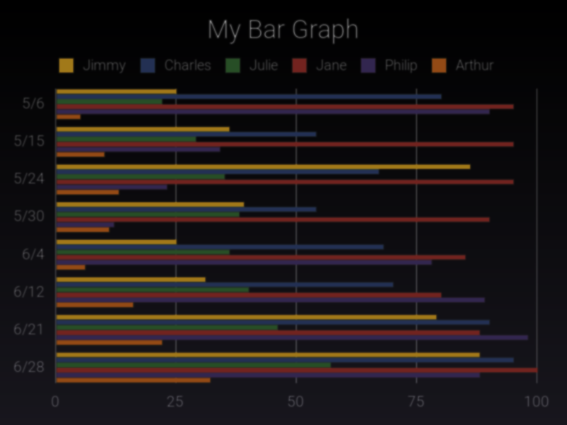
Amazon Sales Dashboard Analysis
Insights generated from Power BI visualizations
Name : G.Pranay Kumar
This Photo by Unknown Author is licensed under CC BY-SA

Slide 2
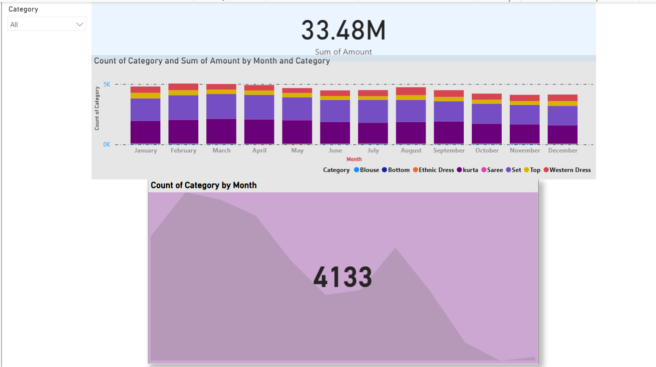
Sales Overview & Top Performers
Total quantity sold: 50K units.
Top style: SET444 with 1.80K in sales.
Top city: Zundal contributing 1.63K in sales.
Top category: 'Set' generating 17M revenue.
Courier activity peaks in December with 4,133 shipments.

Slide 3
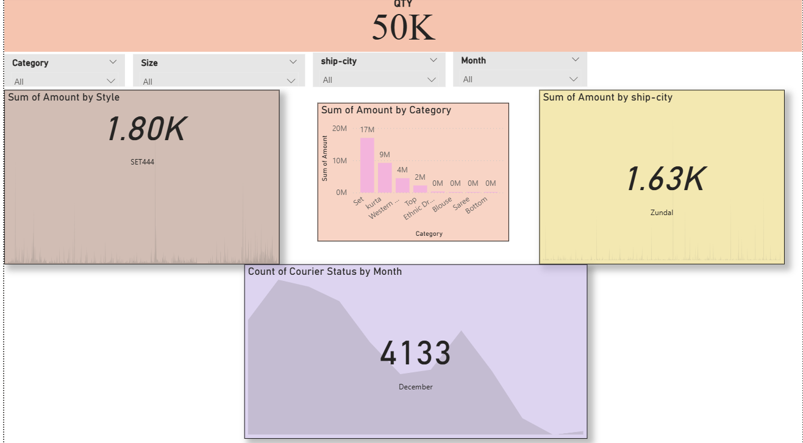
Monthly Trends by Category
Total sales amount: 33.48M.
Sales remain consistent month-to-month.
High contribution from categories: Set, Kurta, Western Dress.
Lower sales in Blouse, Saree, and Bottom categories.
Slight drop in mid-year, rebound towards year-end.

Slide 4
Key Recommendations
- Focus on promoting top categories ('Set', 'Kurta') for higher revenue.
- Explore marketing strategies to boost low-performing categories.
- Target high-value cities like Zundal with localized promotions.
- Prepare inventory for December's courier demand spike.
- Continue monthly monitoring for trend shifts and seasonality.

